Slide 1
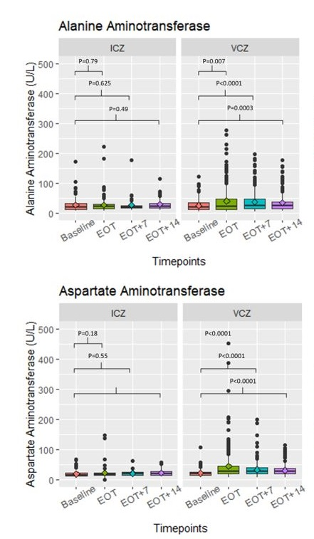
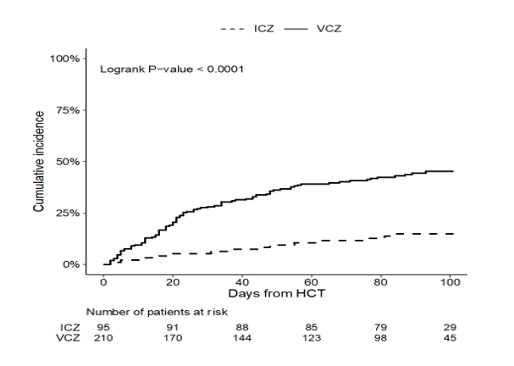
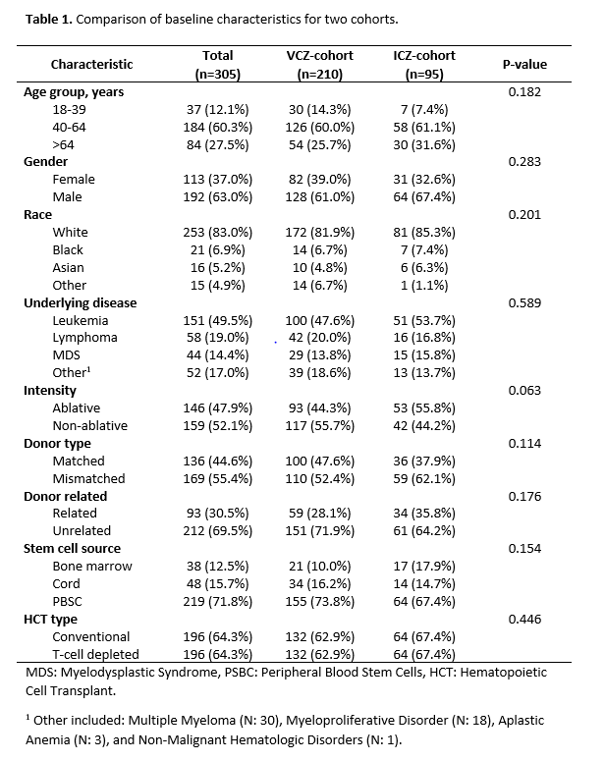
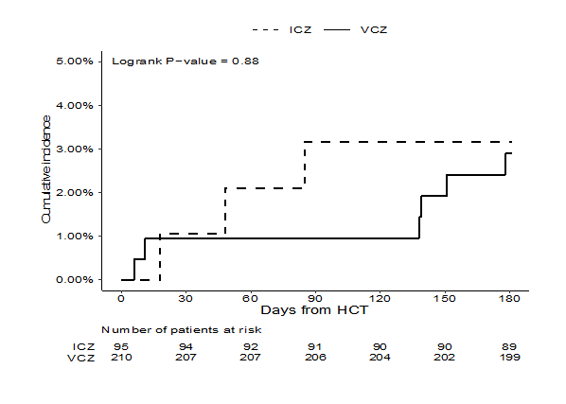
Safety of Isavuconazole Compared with Voriconazole as Primary Antifungal Prophylaxis in Allogeneic Hematopoietic Cell Transplant Recipients
Yael Bogler, MD¹, Anat Stern, MD¹, Yiqi Su, MS¹, Yeon Joo Lee, MD, MPH¹, Susan Seo, MD¹, Sergio Giralt, MD¹, Miguel-Angel, Perales, MD¹, Dionysios Neofytos, MD, MPH³, Genovefa Papanicolaou, MD^{1,2}
¹Infectious Disease Service, Department of Medicine, Memorial Sloan Kettering Cancer Center, New York, NY, ² Medicine, Weill Cornell Medical College, Cornell University, New York, NY, ³Infectious Disease Service, Geneva University Hospital, Geneva, Switzerland
Background
Results
Voriconazole (VCZ) antifungal prophylaxis (AFP) is frequently discontinued in allogeneic hematopoietic cell transplant recipients (allo-HCT) due to toxicities.
Study objectives were to compare 1) rates of AFP premature discontinuation (d/c), 2) changes in transaminases values from start to end of treatment (EOT) and 3) rates of invasive fungal infections (IFI) and all-cause mortality by Day (D) +180 post HCT between VCZ and ICZ AFP
Methods
A matched cohort analysis of 95 patients enrolled in a clinical trial of ICZ AFP from 7/1/2017-10/31/2018 (ICZ-cohort) and 210 pts who received VCZ AFP standard of care between 9/1/2014-12/31/2015 at MSKCC (VCZ-cohort).
The cohorts were matched using propensity scores (Table 1).
Premature d/c of AFP was defined as d/c for IFI or AE by D +100 post HCT or interruption of >14 days for any reason.
Figure 1. Cumulative incidence of premature discontinuation of AFP.
The median (interquartile range) duration of AFP was 94 (87-100) days and 76 (23-94) days in ICZ and VCZ cohorts respectively (p< 0.0001).
Premature d/c occurred in 14/95 (14.7%) of ICZ and 92/210 (43.8%) of VCZ cohorts (p< 0.0001).
Figure 3. Changes in transaminases at baseline and EOT.
The most common cause for AFP d/c was hepatotoxicity: ICZ-cohort: 5/95 (5.26%) vs VCZ-cohort: 48/210 (22.8%). Transaminases at EOT and up to 14 days were increased in VCZ but not ICZ cohort.
Figure 2. Cumulative incidence of IFI among both AFP.
IFI occurred in 3.15% (3/95) in ICZ-cohort and 2.85% (6/210) in VCZ-cohort (p=0.88).
In ICZ-cohort all 3 IFI were Candida bloodstream infections (BSI) occurring on ICZ AFP.
In the VCZ-cohort IFI included one Candida BSI after VCZ d/c, and 5 probable mold infections; 3/5 with serum galactomannan > 0.5 and 2 with beta-D-glucan > 80.
IFI occurred on VCZ in 1 pt and after VCZ premature d/c in 5 pts.
All-cause mortality was 6.31% (6/95) in ICZ-cohort and 2.85% (6/210) in VCZ-cohort (p=0.089).
Conclusions
There was less premature discontinuation and hepatotoxicity with ICZ AFP.
The numbers of IFI were small in both cohorts, however the ICZ cohort had more bIFI than the VCZ cohort.

